Slide 1
Destripando JavaScript
Gonzalo Solano C.

Slide 2
Agenda
Scope
Hoisting
this keyword
Closure
Prototype

Slide 3
Scope - definition
Scope refers to where variables and functions are accessible, and in what context it is being executed. Basically, a variable or function can be defined in a global or local scope. Variables have so-called function scope, and functions have the same scope as variables.(*)
(*) https://robertnyman.com/2008/10/09/explaining-javascript-scope-and-closures/

Slide 4
Scope – definition – cont.
In JavaScript, scope refers to the current context of your code. Scopes can be globally or locally defined.(1)
JavaScript uses the block syntax, but does not provide
block scope: a variable declared in a block is visible everywhere in the function containing the block. (2)
https://toddmotto.com/everything-you-wanted-to-know-about-javascript-scope/
JavaScript The Good Parts - Douglas Crockford

Slide 5
What is Scope in JavaScript?
Where to look for things? Who is looking?
JavaScript has function scope only (*)
Compiler (find declarations of identifiers)
Scope (creates scopes & register declarations (var, function))
Executor (LHS (target), RHS (source))

Slide 6
Sample #1 Simple example
var foo = "bar" ;
function bar( ) {
var foo = "baz" ;
function baz( foo ) {
foo = "bam" ;
bam = "yay" ;
}
baz( ) ;
}
bar( ) ;
console.log( foo ) ;
console.log( bam ) ;
baz( ) ;

Slide 7
Sample #2 Function expressions
var zaz = "zaz" ;
var foo = function bar( ) {
var foo = "baz" ;
function baz( foo ) {
foo = bar ;
console.log( foo ) ;
}
baz( ) ;
console.log( zaz ) ;
}
foo( ) ;
bar( ) ;

Slide 8
Sample #3 IIFE sample
var foo = "foo" ;
( function( ) {
console.log( foo ) ;
var foo = "foo2" ;
baz = "baz" ;
})( );
console.log( foo ) ;
console.log( baz ) ;

Slide 9
Sample #4 Cheating lexical scope
Eval
with

Slide 10
Sample #5 Block scope let
function foo( ) {
var bar = "bar" ;
for( let idx = 0 ; idx < bar.length ; idx++ ) {
console.log( bar.charAt( idx ) ) ;
}
console.log( idx ) ;
}
foo( ) ;

Slide 11
How is error handle?
LHS
Non strict mode
Global scope handles and creates it for us
Strict mode
Reference Error
RHS
Strict/Non strict mode
Reference Error

Slide 12
Resume about scope
Function & block scope &Try { } catch( error ) { }
Type of lookups (LHS, RHS)
Cheating scope (EVAL, WITH)

Slide 13
Lab about scope
Write a function that adds from two invocations
add( 3 )(4) //7

Slide 14
Hoisting - definition
Hoisting is JavaScript's default behavior of moving declarations to the top..(*)
(*) http://www.w3schools.com/js/js_hoisting.asp

Slide 15
Sample #1
foo( ) ;
function foo( ) {
console.log( 1 ) ;
}
var foo = function( ) {
console.log( 2 ) ;
}
function foo( ) {
console.log( 3 ) ;
}
function foo( ) {
console.log( 1 ) ;
}
function foo( ) {
console.log( 3 ) ;
}
foo( ) ;
var foo = function( ) {
console.log( 2 ) ;
}

Slide 16
Lab #2 scope and hoisting
# Instructions
Fix the code so it prints out the alphabet A-Z in the console.
2. Cannot:
- Have **any** global variables at all
- Delete or combine any function declarations
- Create any new functions (except IIFEs -- hint!)
- Rearrange the order of declarations
3. Can/must:
- Declare extra variables (as long as they're not global)
- Modify (in-place) function declaration/initialization
- Add/remove statements/expressions (IIFEs, return, params, etc) - Make the fewest changes possible

Slide 17
this keyword
Every function, while executing, has a reference to its current execution context, called this.

Slide 18
Misconceptions
Assume this refers to the functions itself (sample-1.js)
Assume that this somehow refers to the function’s scope (sample-2.js)

Slide 19
Setting this in context
When a function is invoked, an activation record, otherwise known as an execution context, is created. This record contains information about where the function was called from (call-stack), how the function was invoked, what parameters were passed, etc. One parameter is the this reference

Slide 20
The call-site
To understand how this is bind, understand the call-site, the location in code where a function is called, we must inspect the call-site to answer the question: what is this or reference to

Slide 21
Rules
4. Default binding
3. Implicit binding
2. Explicit binding (call or apply)
1. Using new keyword

Slide 22
Closure
Closure is when a function “remembers” its lexical scope even when the function is executed outside that lexical scope.

Slide 23
Closure - Samples

Slide 24
Closure - Lab
Create a function, which returns an array of functions, which return their index in the array
var callbacks = createFunctions(5);
// create an array, containing 5 functions callbacks[0](); // must return 0
callbacks[3](); // must return 3

Slide 25
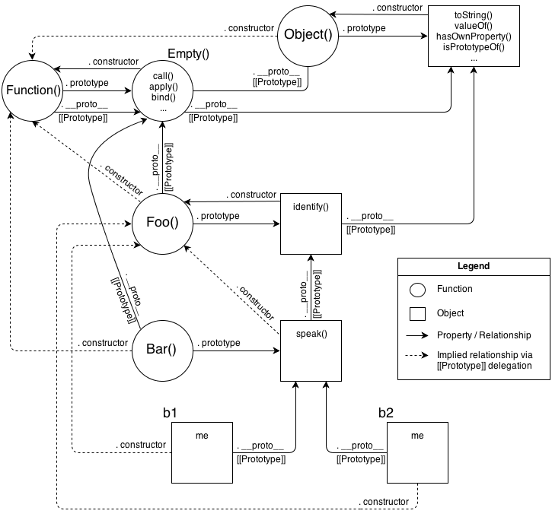
Prototype

